Slide 1

19CSE304 – Foundations Of Data Science
Case Study on Food Delivery Profit Analysis
Year: 2024-2025 (Odd Semester)
Presented by
K. Chaitanya Sai – AV.EN.U4CSE22121

Slide 2
Introduction
The food delivery industry plays a pivotal role in modern urban lifestyles, bridging the gap between restaurants and customers. Within this ecosystem, delivery personnel serve as the backbone, ensuring seamless delivery experiences. However, their profitability is often influenced by multiple factors, including order value, delivery charges, discounts, and operational costs such as commission fees and payment processing fees.
This case study seeks to evaluate the net profitability of delivery boys by leveraging a comprehensive dataset. The dataset encapsulates key metrics across financial, operational, and temporal dimensions, offering an opportunity to not only calculate profits but also to identify patterns and trends that affect earnings. The findings aim to provide actionable insights that can optimize delivery operations and enhance earning potential for delivery personnel.

Slide 3

Goals and Objectives:
Dataset Exploration: Understand the dataset’s structure and identify key variables that influence profitability, such as:
Revenue components: Order Value and Delivery Fee.
Cost components: Commission Fee, Payment Processing Fee, and Refunds/Chargebacks.
Promotional factors: Discounts and Offers.
Temporal data: Order and delivery times for efficiency analysis.
Profit Calculation: Develop a formula to compute the net profit per order:
Insights Generation:
Analyze patterns in profitability based on order value, delivery charges, and regional or customer demographics.
Examine the impact of discounts and offers on net earnings.
Identify time-based trends, such as peak hours or days when earnings are higher.
Recommendations: Propose strategies to improve profitability, including:
Optimizing delivery fees.
Reducing operational costs.
Designing better promotional campaigns to benefit both customers and delivery personnel.

Slide 4
Dataset Description
The dataset captures comprehensive details about food delivery orders, enabling an in-depth analysis of profitability for delivery personnel. It includes financial, temporal, and operational metrics, with 1,000 entries and 12 columns. Below is a detailed description of each column:
Dataset Columns:
Order ID:
Description: A unique identifier for each order.
Customer ID:
Description: A unique identifier for the customer placing the order.
Restaurant ID:
Description: A unique identifier for the restaurant fulfilling the order.
Order Date and Time:
Type: String (to be converted to datetime)
Description: The timestamp when the order was placed.

Slide 5
Delivery Date and Time:
Description: The timestamp when the order was delivered to the customer.
Order Value:
Description: The total monetary value of the order, excluding any fees or discounts.
Delivery Fee:
Description: The fee charged to the customer for delivery services.
Payment Method:
Description: The method used for payment (e.g., Credit Card, Digital Wallet, Cash on Delivery).
Discounts and Offers:
Description: The discounts or promotional offers applied to the order. Values are textual and require standardization for analysis.
Commission Fee:
Description: The fee deducted by the platform from the order value for operational expenses.
Payment Processing Fee:
Description: The fee associated with processing the payment method chosen by the customer.
Refunds/Chargebacks:
Description: the amount deducted due to refunds or chargebacks for the order

Slide 6
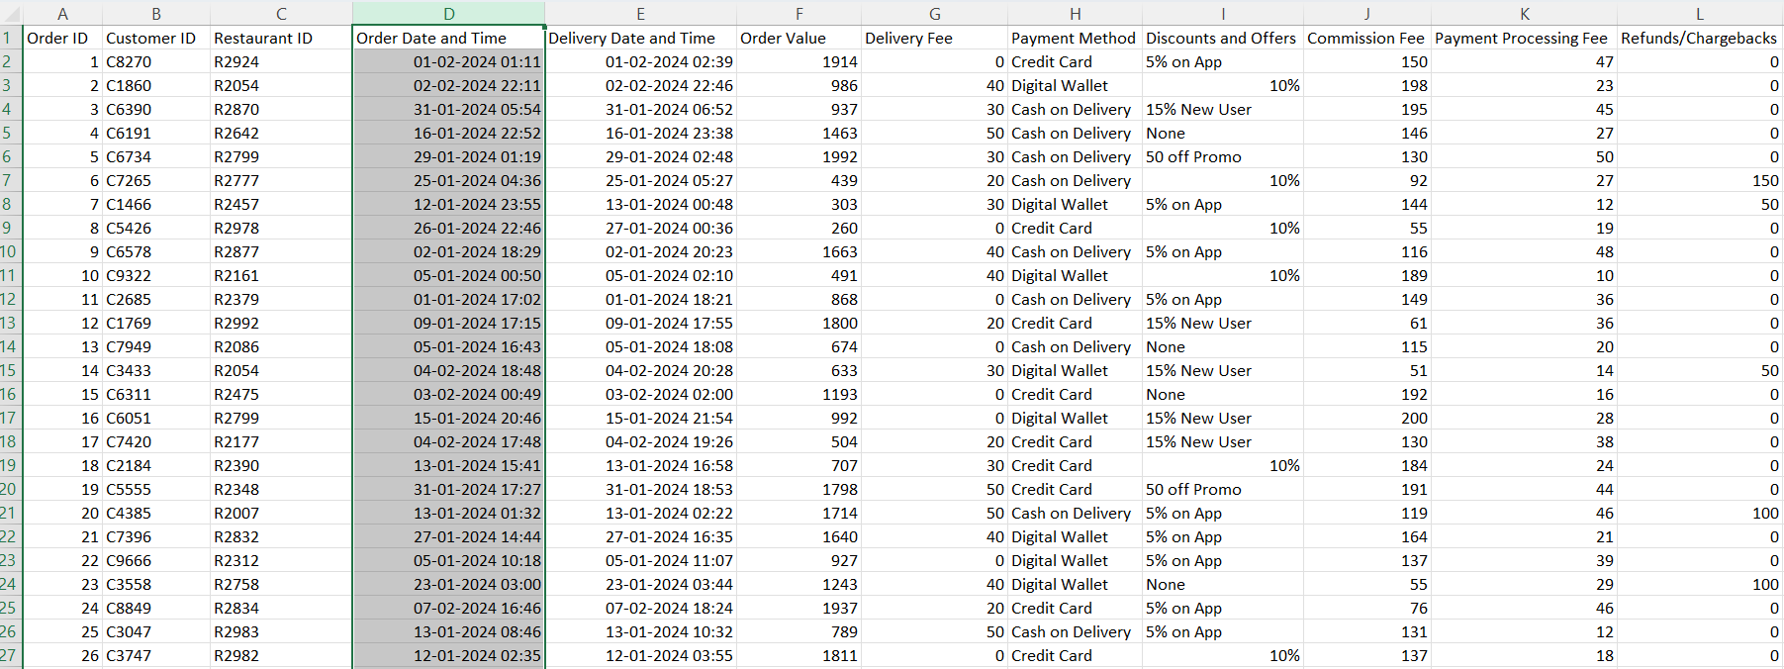

Slide 7
Data Preprocessing
This section outlines the steps taken to prepare the dataset for analysis by cleaning, transforming, and calculating relevant metrics.
1. Data Sources
The dataset includes key details about food orders, such as order value, delivery fees, commissions, payment methods, and discounts, enabling profitability calculations.
2. Data Cleaning
Handling Missing Data:
Missing values in the Discounts and Offers column are replaced with a placeholder indicating no discount.
Transformations:
Textual discount values like "5% off" are converted into numerical values (percentage or monetary).
3. Date Parsing
Columns Order Date and Time and Delivery Date and Time are converted to datetime format to calculate delivery durations.
4. Discounts and Offers Processing
Percentage Discounts:
Extract numeric percentages and calculate their monetary value (e.g., 10% of order value).
Adjustment:
Discounts ≤15% are treated as percentage-based, enabling accurate cost adjustments.
5. Calculating Total Cost
Total cost = Delivery Fee + Discount Value + Payment Processing Fee. This represents the overall expense for processing each order.
6. Calculating Profit
Profit = Commission Fee - Total Cost. This highlights the net earnings per order, factoring in all costs.

Slide 8
Visualization Analysis
This section visualizes cost distributions and profit patterns to identify key trends and insights.
1. Cost Distribution
Bar Plot:
Visualizes the total sum of costs (Discounts, Delivery Fees, Payment Processing Fees), highlighting which cost contributes most to the overall expenses.
Pie Chart:
Displays the proportion of each cost category as a percentage of total costs, offering a clear view of major expense areas.
2. Profit Distribution
Bar Plot:
Compares total Commission Fees, Total Costs, and Profits to assess revenue versus expenses. A larger gap between Commission Fee and Total Cost indicates higher profitability.
Histogram:
Shows the frequency of profit values, revealing the spread of profits across all orders. Peaks represent common profit levels, while a wider spread highlights variability.

Slide 9
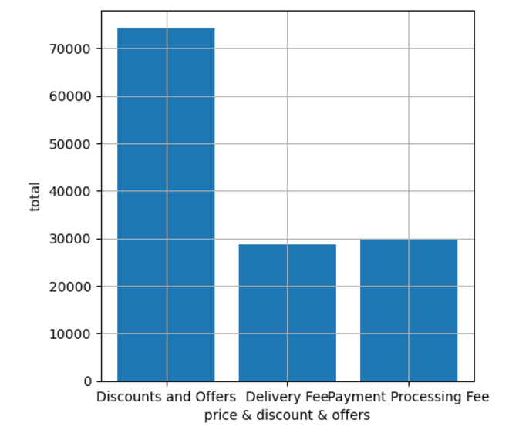
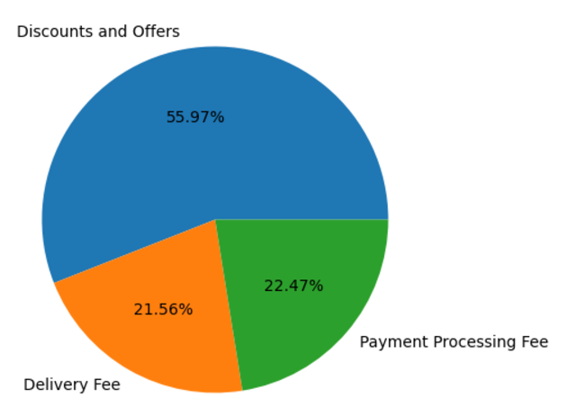
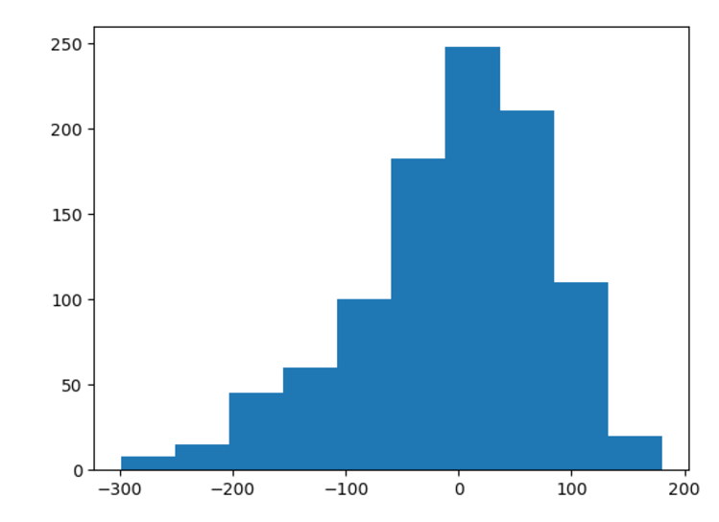

Slide 10
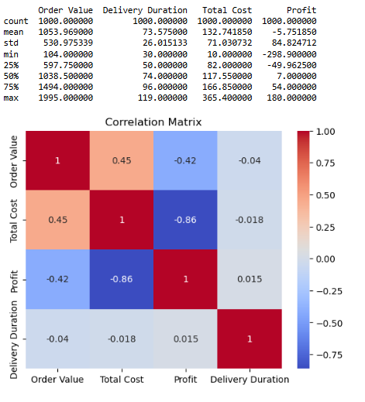
Descriptive Analysis
Descriptive Statistics:
Metrics like mean, median, and standard deviation are calculated for key financial columns such as Order Value, Delivery Fee, and Commission Fee.
Profit =Commission Fee – ( Delivery Fee + Discount and Offers + Payment Processing Fee )
Key Findings:
Trends show higher profits with specific payment methods.
Certain time periods yield higher profits, indicating peak demand or efficient delivery patterns.

Slide 11
Inferential Analysis
Correlation Analysis:
Purpose: Explore the relationship between Delivery Fee and Profit.
Key Metrics: Correlation coefficient (strength and direction) and p-value (statistical significance).
Aim: Determine if delivery fees influence profitability, guiding pricing strategies.
A/B Testing (T-Test):
Purpose: Compare mean profits for orders paid via Cash on Delivery vs. Credit Card.
Key Metrics: T-statistic (group difference) and p-value (significance).
Aim: Identify which payment method yields higher profits.
Bootstrapping:
Purpose: Estimate mean profit and confidence intervals using resampling.
Key Metrics: Bootstrapped means and 95% confidence intervals.
Aim: Provide robust profit estimates under varying conditions.

Slide 12
Classification Modeling
Predictive Modeling
Predictive modeling forecasts profits based on factors of Profits.
Regression Modeling:
Purpose: Predict continuous profits.
Metrics: RMSE (error magnitude), MAE (average error), R² (explained variance).
Model: Linear Regression for interpretable relationships.
Classification Modeling:
Purpose: Categorize profits (e.g., High, Low).
Metrics: Confusion Matrix, Accuracy, Precision, Recall, F1-Score, ROC Curve, and AUC.
Models: Logistic Regression, KNN, Random Forest.
Bootstrapping:
Purpose: Validate metric stability (e.g., RMSE, Accuracy) and create confidence intervals using resampling.
Model Comparison:
Logistic Regression: Simple and interpretable.
KNN: Handles non-linearity, sensitive to scaling.
Random Forest: High accuracy, non-linear relationships, and feature importance insights.
Comparision using Roc Curve analysis

Slide 13
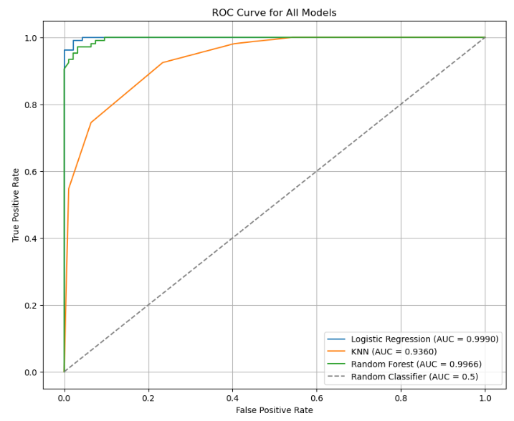

Slide 14
Conclusion and Insights
Hypothesis Testing:
Delivery Fee positively correlates with Profit, indicating potential profitability with reasonable fee increases.
Credit Card orders yield higher profits than Cash on Delivery.
Descriptive Insights:
Average profit per order: ~$950, influenced by Order Value, Discounts, and Delivery Fees.
Payment methods and operational fees are key profit drivers.
Modeling Results:
Regression models effectively explained Profit variations (high R²).
Bootstrapping confirmed metric stability with low RMSE.

Slide 15
Implications:
Business Strategy: Optimize Delivery Fees, encourage Credit Card use, and offer targeted promotions to balance customer satisfaction and profits.
Decision-Making: Monitor delivery durations and implement dynamic pricing based on order value and location.
Limitations:
Data approximations for Discounts and Offers might affect accuracy.
Bootstrapping and A/B testing excluded some variables and payment methods.
Future Directions:
Include predictors like customer demographics and restaurant ratings.
Explore advanced non-linear models and profit classification approaches.
Refine pricing strategies with additional insights into cost-profit dynamics.

